Slide 1
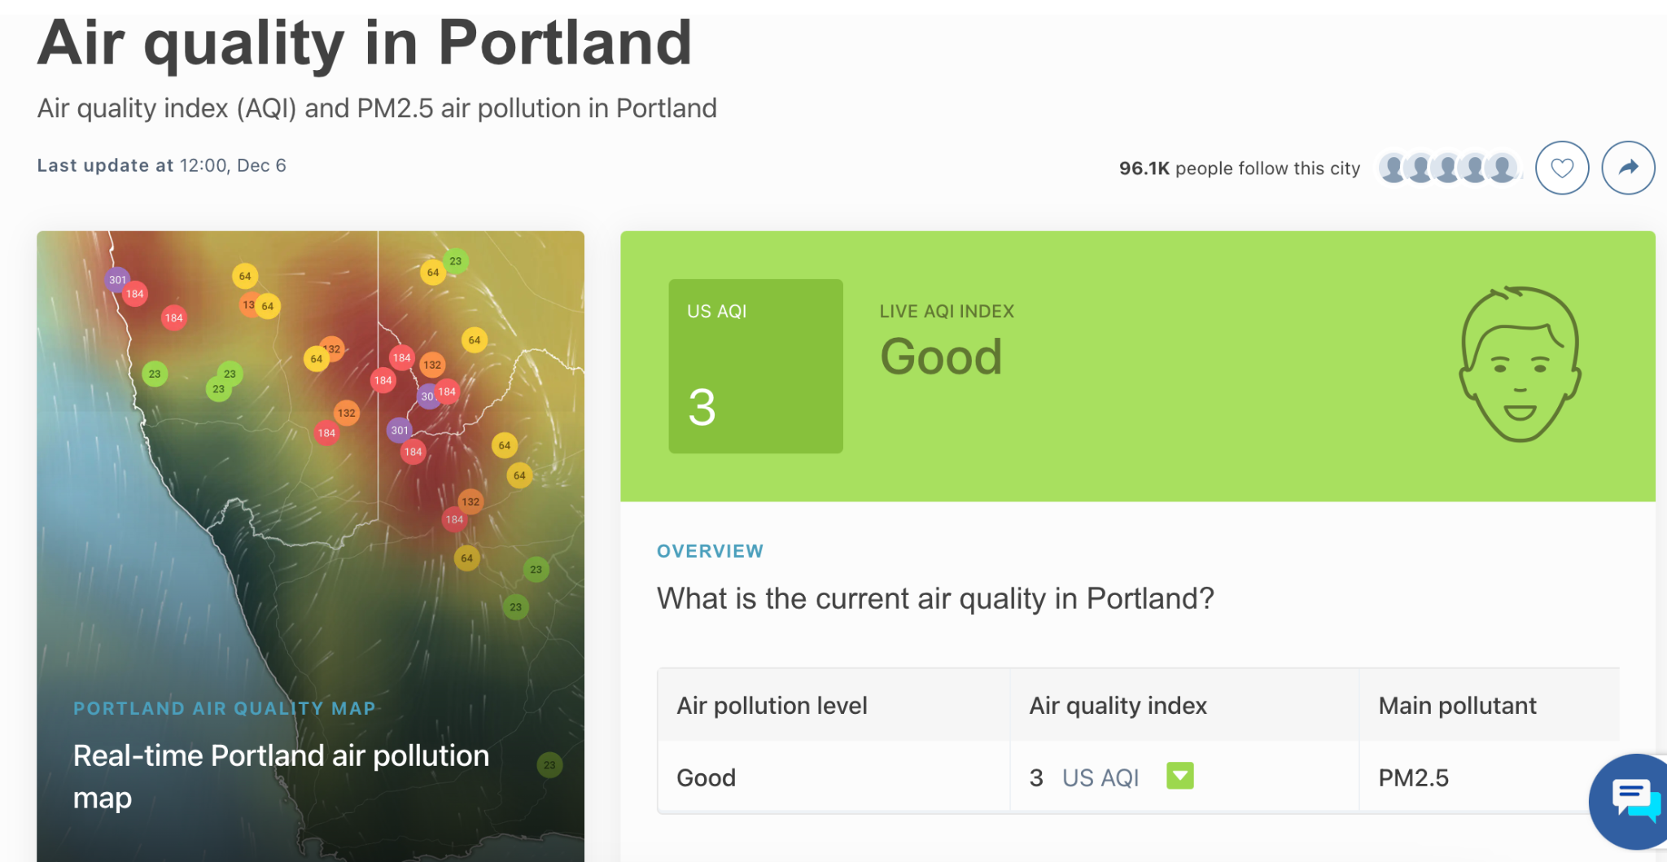
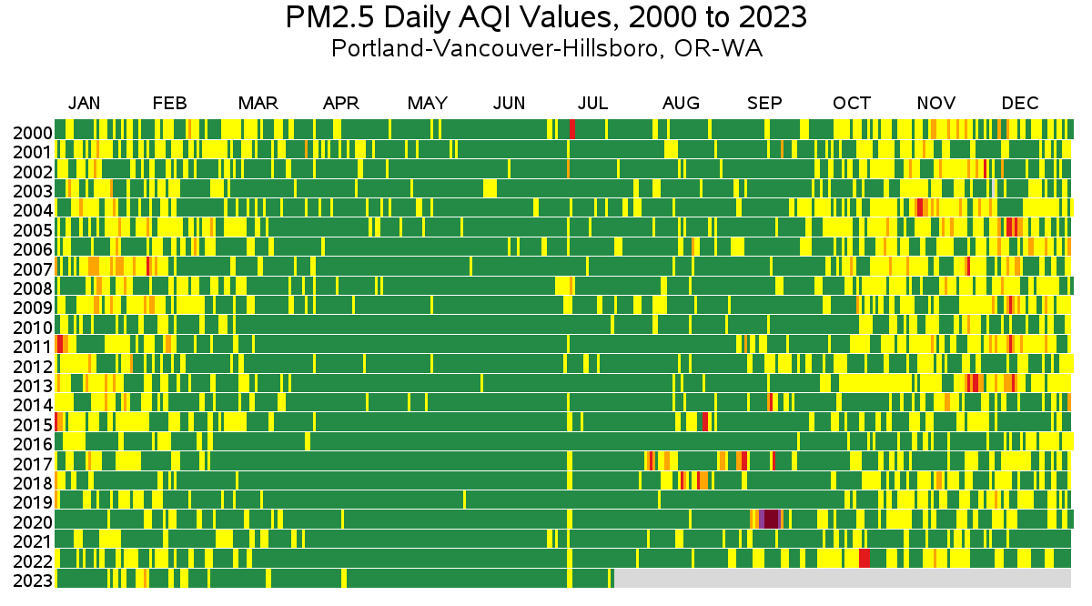
Air Quality Index (AQI)
So far…
Talked about what you know
Researched factors of AQI
Used Data Science to look at large data sets
Next…
Pose a question and design a lab!

Slide 2
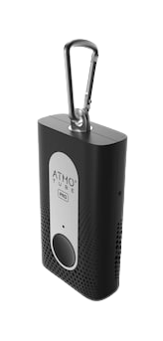
Exploration with Atmotubes
Please be careful!
One person in each group, please download the Atmotube app on your phone.
Connect to the Atmotube via Bluetooth.
Try out the app. Pay attention to what kind of data it’s collecting. We will be using it to collect data.
Notes:
Teacher notes:
This is an exploration time to familiarize students with new equipment.
Set up a few stations around the room where students can test the effects of different conditions. These can be as basic as inside and outside the classroom or building. Other options include: near a lit match, near a bunsen burner, near a spray of cleaning solution.

Slide 3
Exploration with Atmotubes
On the document in Google Classroom, record what you notice about:
what kind of data is being collected
which AQI factors are being measured
how long it takes to get a reliable reading
if your proximity to the device seems to be affecting the readings

Slide 4
What did you discover?
What did you notice while you were playing with the Atmotubes?
What did you test that made a big difference to the air quality?
What questions do you have about testing air quality?

Slide 5
Pose a Question and Design an Experiment
Step 1: Pose a question that can be answered here at school using the Atmotubes
Consider:
What data is being collected
Which AQI factors are being measured
How long it takes to get a reliable reading
Step 2: On the assignment linked in Google Classroom, explain your experiment
You must:
Propose a question
Describe how you will answer this question and what data you will collect
Describe how you will present this data
Get approval from your teacher before you begin

Slide 6
Perform Experiment and Write a CER
Step 3: Perform your experiment
Collect and record data
Consider how you will present your data (graph, table, map, other ways?)
Step 4: Write your CER
Claim: What question were you trying to answer? What did you discover?
Evidence: Include evidence from your experiment (graphs, measurements, etc). I can help you create a graph on paper or computer.
Reasoning: Define air quality. Explain how the data you collected helped you answer the question in your claim.

